Slide 1
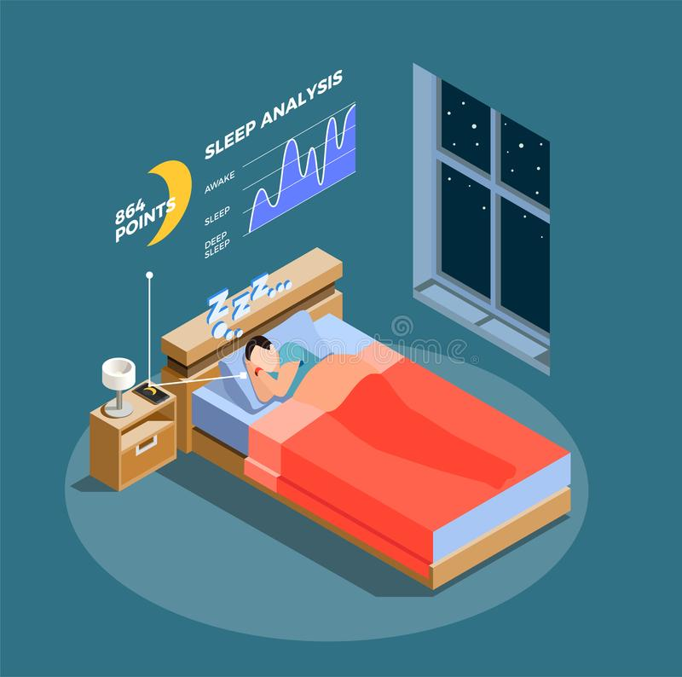
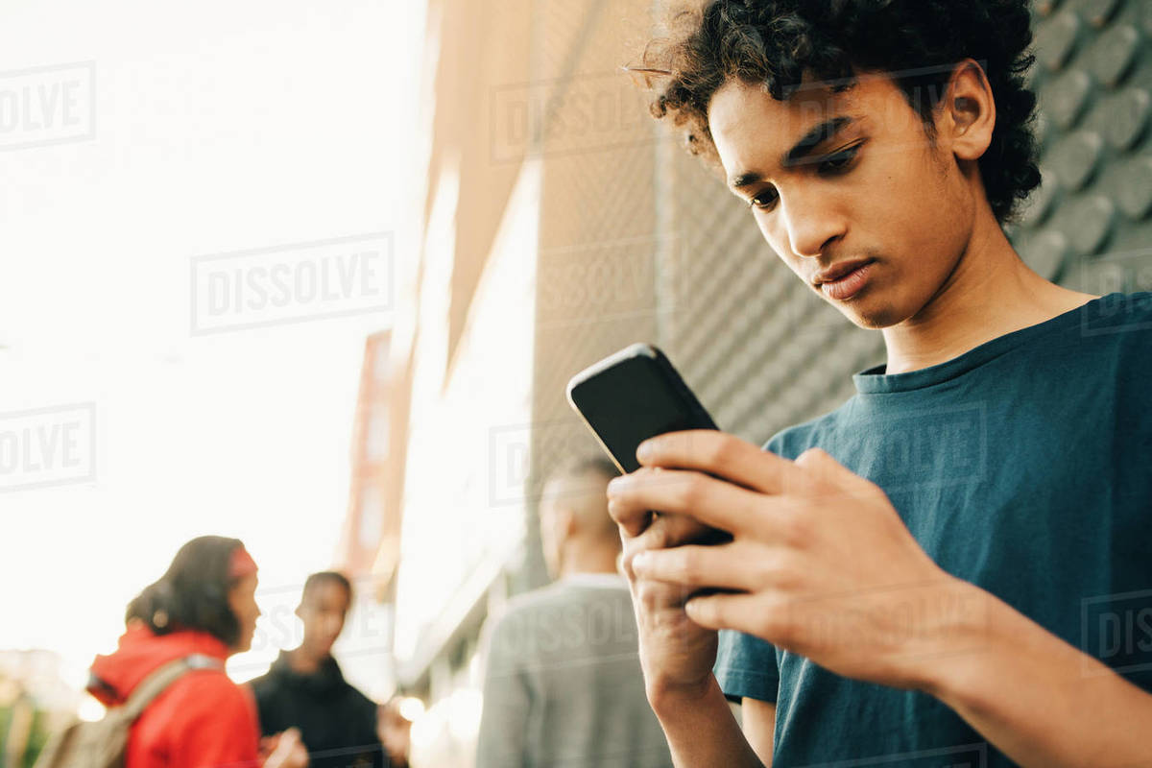
Significance
Future Research
The Impact of Technology Use Before Sleep and its Effects on Implicit and Explicit Memory Retention
This research could have a variety of implications on adolescent life. It could provide support for why schools should have later start times, as the homework done electronically may result in shorter sleep time, which adversely impacts memory. It also provides guidance as to how students should study, so they avoid technology before sleep the week of a big test to make sure their studying is as effective as possible. Additionally, since technology is constantly becoming more advanced, it’s important to keep updating research as old technology becomes obsolete. Finally, the prevalence that technology has in the lives of our adolescent population combined with the fact that we don’t fully understand how technology affects the developing brain means that research like this is very important.
In the future it would be interesting to conduct a similar study with an adult population in order to compare the results with this study to see if there is a difference. It would also be interesting to do this research but modified to study short term memory.
Literature Review
For over two decades, scientists have known that sleep improves long term memory. ​
Karni et al. (1994)​
REM sleep and slow wave sleep have each been proven to improve memory. ​
Karni, et al. (1994)​
Sleep deprivation negatively impacts implicit memory​
Schacter, et al. (1987) ​
More screen time is related to lower sleep quality. ​
Lemola, et al. (2014)​
More screen time is related to shorter sleep time.​
Taveras, et al. (2015) ​
Exposure to a screen before sleep leads to poorer perceived rest.​
Falbe et al. (2015)​
https://www.dreamstime.com/illustration/research-sleep.html
Lauren Radicchi
Pawling High School
References
Alhola, P., & Polo-Kantola, P. (2007). Sleep deprivation: Impact on cognitive performance. Neuropsychiatric disease and treatment, 3(5), 553–567.
Cherry, K. (2019). What's the Difference Between Implicit and Explicit Long-Term Memory? Retrieved June 17, 2020, from https://www.verywellmind.com/implicit-and-explicit-memory-2795346
https://dissolve.com/stock-photo/Teenage-boy-using-mobile-phone-while-friends-standing-royalty-free-image/101-D929-57-475

Slide 2
Sleep
Technology Requirements
Results
Sleep is a naturally occurring state of both the mind and the body characterized by altered consciousness, somewhat inhibited sensory activity, inhibition of most voluntary muscles, and reduced interactions with surroundings
For the purposes of my research I had three groups of participants divided by the amount of technology they were allowed to use in the hour before sleep. The no technology group couldn’t use any technology with a screen in the hour before sleep, the can use technology group could use as much technology as they wanted in the hour before sleep, and the must use technology group. The groups followed these limitations for 2 weeks.
We analyzed the sleep diary data with descriptive statistics in order to identity broad trends or patterns. The group who used no technology showed the highest scores except for overall changes to daytime sleepiness, which was most improved in the can use technology group. The memory tasks were analyzed with ANCOVA tests (p<.05). We found that only one memory task, the explicit memory one, had significant results. Through analyses of the post-surveys done, we also found a negative correlation between technology use before sleep and feelings of improved morale and focus. There was also a positive correlation between technology use before sleep and daytime sleepiness.
Memory
Implicit memory is any memory which is recalled subconsciously, like breathing. Explicit memories are memories that a person consciously recalls, consisting of memories of facts, memories of experiences and memories about oneself.
Sleep Recordings
In order to get both a quantitative and qualitative measurement of sleep time & quality, we used two methods of recording sleep. Sleep diaries were used as the qualitative measure. Participants filled them out twice a day, once in the morning and once at night. In order to get a quantitative measure, we used the sleep tracker known as the Oura Ring, which records body temperature, heart rate and other physiological factors which influence sleep quality.
Technology and Sleep
Discussion
Research has shown that using technology, especially technology with a screen interface, worsens sleep quality and decreases sleep time.
The results of this study show that technology use before sleep has a partial effect on memory, as it was shown to significantly impact explicit memory but not implicit memory. Technology harms our bodies because it keeps the mind stimulated and the light emitted by a screen inhibits melatonin production. There were some limitations to this research. Firstly, the sample size was very small (n=9), so the results of this study may not reflect a more general population. Additionally, due to the price of the Oura Rings, we were only able to purchase three, which limited the number of participants we could do at a time.
Memory Tasks
After the two week experimental period, the participants were asked to complete two memory tasks, one for explicit memory and one for implicit memory, The tasks started with a ten minute encoding period during which the participants tried to memorize a list of words. Then there was a five minute distraction period to ensure they didn’t use short term memory. Finally there was a ten minute recall period when the participants had to recall however many words they could remember.
Sleep and Memory
For over two decades, scientists have hypothesized that sleep improves long-term memory. Good REM & slow-wave sleep have been shown to improve memory. Slow-wave sleep helps with the consolidation of explicit memory and implicit memory.

