Slide 1
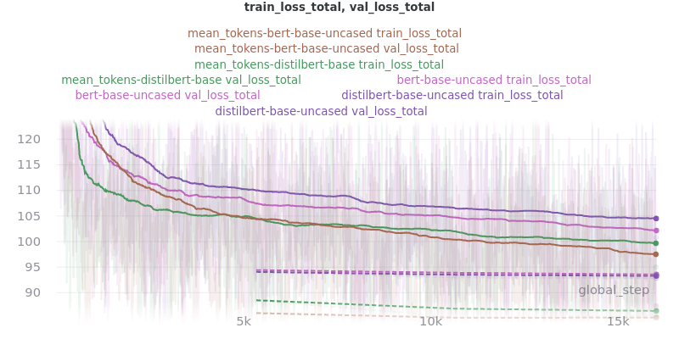
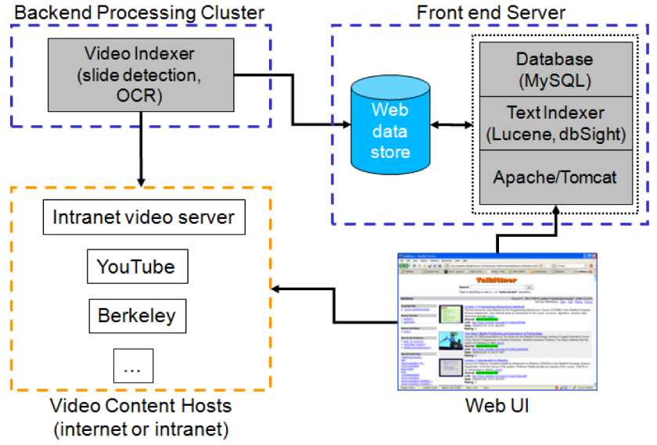
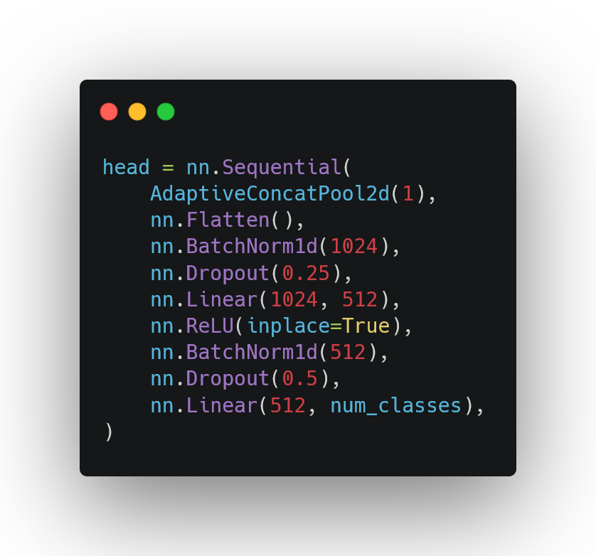
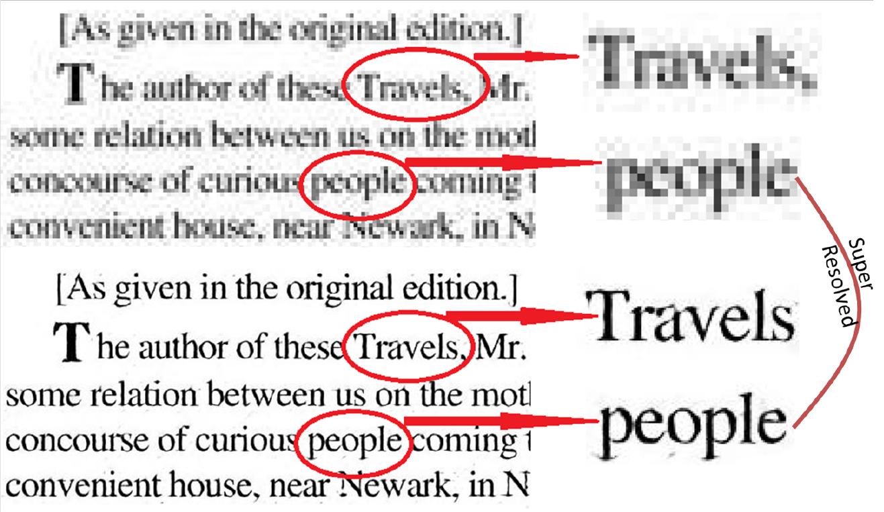
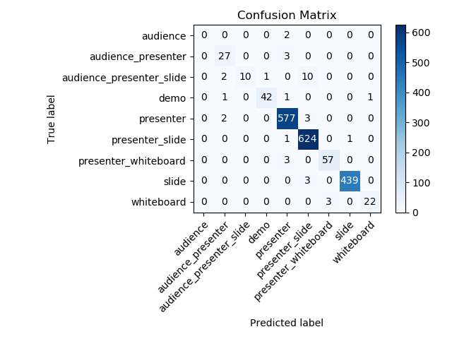
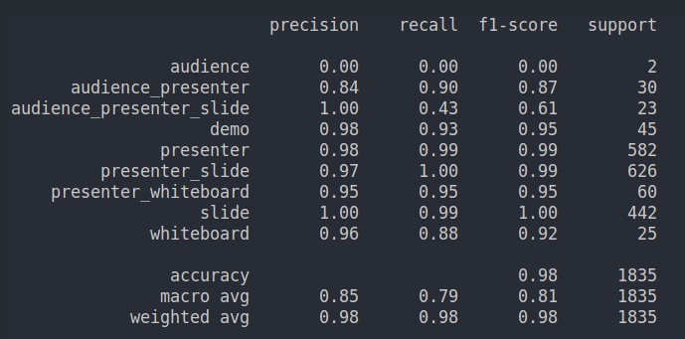
Lecture2notes: Summarizing Lecture Videos by Classifying Slides and Analyzing Text
Hayden Housen • haydenhousen.com • Pawling High School
Introduction
Gap in Research & Purpose
Methodology – End-to-End Approach
Any images not cited are my own.
TransformerExtSum Partial Results
Computer Vision (CV)
Definition: Interdisciplinary scientific field that attempts to give computers the ability to understand digital images and videos.¹
Goal of CV: Create computational models of functions & abilities associated with human visual system.²
Gap in Research
Purpose
Extract Frames
Classify Frames
Perspective Crop
Cluster Slides
OCR Slides
Transcribe Audio
Summarize
Notes Designer
My Improvement
CV Tasks:
Object detection
Segmentation
Pose estimation
Action recognition
OCR
Classification
1
There is no ML model to classify slides in lecture videos or up-to-date dataset of lecture videos
Train a ML model to classify slides and create a dataset of lecture videos that contains many different topics and styles.
BertSum
Summarization Models
My Improvement
Slide Classifier
BertSum
Loss graphs from pooling experiment
Amount of Data: Video data accounted for 75 percent of the total internet traffic in 2017.⁵ This percentage is predicted to increase to 82% in 2022, making video a vital source of information for computers to use.⁵
CV Significance:
2
No robust combination-based summarization model has been applied to lecture videos.
Merge various combination approaches (keywords, concatenation) with extractive and abstractive summarization models.
= Novel ML Models
= Novel Approaches
Pooling mode improvements associated with a 0.617 average ROUGE F₁ score improvement.
Notes Designer
Face Recognition
Emotion Analysis
Sports: draw lines on field
Medical Imaging
Movie Special Effects
Self Driving Cars
3
No end-to-end process to summarize slide presentations
Use various algorithms (OCR, clustering, ASR) to fuse all components together
Basic formatting (bold, italics, etc.) from OCR
Features specific to notes (headings, etc.) will be generated by the Notes Designer
Implementation details not determined
Natural Language Processing (NLP)
Definition: Field that gives computers the ability to read, understand and derive meaning from human languages.²⁸
Goal of CV: Read, decipher, and understand of the human languages in a manner that is valuable.²⁹
NLP Significance:
NLP Tasks:
Speech recognition
Machine translation
Language modeling
Question answering
Simplification
Summarization
4
Both a web app for public use and an API for developers do not exist.
Launch model into production though a user friendly web app
Perspective Crop: Detect the bounding box of slide in frame & automatically crop to bounding box
Clustering
Normal: Groups slides based on features (visual similarities) extracted from Slide Classifier CNN
Affinity Propagation and K-Means
Frames
Classifier
Screen Capture
Group Together
Methodology – Website
Methodology – Slide Classifier
Video Camera
Perspective Crop
User
User Data
Spam filters
News tracking
Voice Assistants
Chatbots
Translators
Grammar Checking
Similar slides are clustered together
Eliminates duplicate frames that show same slide (removes transitions)
Segment: Iterates through the extracted slides in order
Marks a split when the cosine similarity between the feature vectors differs by a value greater than the mean of the cosine similarities
Image Hashing (Optional): Detects near duplicate images
OCR: Recognizes and “reads” the text embedded in images. Uses Google’s Tesseract-OCR Engine
My Flask Template
Customize
Deploy
Web Server
Collection of Lecture Video Dataset (LVD)
Video Sources: Online University Lectures (MIT OpenCourseWare), MOOCs, YouTube (and other video sharing websites)
Backend Cluster
AI Prediction
Artificial Intelligence & Machine Learning (AI & ML)
Note Taking
Sorting
Conclusion & Future Focus
Artificial Intelligence
Machine Learning
Note taking is almost a universal activity among students.³⁰
Students’ notes are generally incomplete, and thus not adequate for reviewing the material.³¹
Those that review instructor provided notes score higher than those who review their own notes.³¹
Students prefer guided notes³² and course final exam performance higher for guided notes.³³
Website Scraper
Videos CSV
Auto Sort (AI Classification)
Bootstrapping
Transcribe Audio
YouTube: If the video to be converted to notes is on YouTube, download the transcript directly from YouTube and apply minimal processing (remove speaker names). Human-made transcripts improve summarization (less error from speech-to-text process)
General: Sphinx and Google Speech Recognition.
DeepSpeech
Architecture created by Baidu in 2014. Project DeepSpeech created by Mozilla (Firefox) to provide open source community with Speech-To-Text engine.
5.97% word error rate on the LibriSpeech clean test corpus (one of many speech datasets).
Audio File (WAV) → Transcript (TXT)
Chunking
Chunking increases voice-to-text speed by reducing amount of audio without speech
Voice Activity: Uses WebRTC Voice Activity Detector (VAD) – reportedly one of the best VADs available, being fast, modern, free
Noise Activity: Detects segments of audio that are significantly below the average loudness of the file.
Human intelligence exhibited by machines ^{6,7,8}
YouTube Scraper
Video Downloader
Frame Extractor
Compile Data
Machines improve without being explicitly programmed ^{9,10,11}
Slides Scraper
& Downloader
Slides CSV
pdf2img
Summary
Contribution: This research’s contribution is five-fold
Manual Sorting Repairs
Train Slide Classifier
Lecture Video Dataset
Appropriate categories
Slide Classifier
Identify important frames in slide presentations
Online Web Service
Allows anyone to automatically create notes based on their own lectures
End-To-End
Multimodal approach
Convert lecture videos to notes
Large variety
Summarization Models
Improve state-of-the-art in text summarization
Novel approaches
Deep Learning
Multilayered neural networks learn from vast amounts of data
Effects in Education
LVD Mass Collection
Parse data
Learn from it
Predict something in world
Previewing: Summarized lecture slides reduce amount previewing time without impacting quiz scores³⁴
Automated summaries will
Decrease time to create notes
Improve content knowledge
Enable faster learning
YouTube Keywords
Extract Frames
CSV Order By Lowest Scores
Manual Sorting Repairs
Multimodal Approach
Audio: Transcribed using Speech-to-Text.
Video: Key frames selected, perspective cropping, clustering, text recognition.
Both: Combine audio and video components, then summarize, then design notes.
YouTube Scraper
Download Video
For Each Scraped Video
Classify Frames
Compile Data
Human Interaction
Frame Selector
Edge Detection & Cropping
Clustering
(Key Frames)
Videos CSV
Calculate Average Certainty
Train Slide Classifier
Video
Video Keyframe Every Second
Literature Review
Machine Learning Workflow
Methodology – Summarization
Slide Classifier
Text Recognition
Notes
Testing Dataset
Extractive vs Abstractive
Extractive: Identifies important sections of the text and generates them verbatim producing a subset of the sentences from the original text (copy & paste).
Abstractive: Reproduces important material in a new way after interpretation and examination of the text using advanced natural language (synthesize new content).
Combination Algorithm
Audio Transcript
Slides Transcript
Lecture
Slides
Not Slides
OCR
Notes Designer
Video Retrieval
“TalkMiner: A lecture webcast search engine” by Adcock et al.²³ – Web scraping and OCR used to index online lecture videos.
Prediction
Combination Algorithm
Audio
Spell Checker
Video Summarization
Goal: Given an input video, goal is to select subset of frames to create summary video that optimally captures important information of input video¹⁸ (key frame selection problem¹⁹)
Data
Training Dataset
Algorithm
Evaluation
Model
Summarization Model
NLP
Transcription
Combination Algorithm
Text Summarization
Summary of TalkMiner [23]
only_asr – only uses the audio transcript (deletes the slide transcript)
only_slides – reverse of only_asr
concat – appends audio transcript to slide transcript
full_sents – audio transcript appended to only the complete sentences of the slide transcript
keyword_based (most advanced) – selects a certain percentage of sentences from the audio transcript based on keywords found in the slides transcript
Summarization Algorithm
Modifications (Get only complete sentences)
Extractive Summarization
Cluster – groups lecture transcript into categories & summarizes each using “generic”
Generic (non-neural) – uses algorithms from sumy package: lsa, luhn, lex_rank, text_rank, edmundson, random
Abstractive Summarization
PreSumm or BART or TransformerExtSum
Neural Summarization Models
PreSumm: Based on BERT, which is pretrained language model (understands English language) that can be applied to NLP tasks. Applied BERT to text summarization.
BART: BART is trained by:
Corrupting text with an arbitrary noising function
Learning a model to reconstruct the original text
Finetuning to summarize
TransformerExtSum: Created by HHousen. Improves the architecture of BertSum (extractive component of PreSumm)
Future Focus
After Research:
Promote the service and get educators and students to use it
Investigate impact on education: Does lecture summarization give teachers more time? Does it improve student’s grades if used a certain way?
Solutions: LSTM and Fully Convolutional Sequence Networks^{18,20}
“Robust handwriting extraction and lecture video summarization” by Lee et al.²¹ – Extract handwriting & summarize using HELVS method. Requires two cameras.
“Automatic Summarization of Lecture Slides for Enhanced Student Preview” by Shimada et al.²² – Generates summarized set of lecture slides. Found that the summarized slides reduced amount of previewing time required with no effect on test scores
Highlight Detection
“Automatic Curation of Sports Highlights using Multimodal Excitement Features” by Merler et al.²⁵ – Sports highlights used by 2017 Masters 2017 Wimbledon, and US Open. Combines player reaction, spectators, and commentator though visual and auditory info.
Slide Classifier Model
Models: Efficientnet, Resnet, Alexnet, VGG, Squeezenet, Densenet, Inception
Optimizers: Ranger (RAdam + LookAhead) and AdamW (OneCycleLR scheduler)
Modified architectures for better pre-training/feature extracting
Production Data
Acknowledgements
OCR Super-Resolution
“Enhancing OCR Accuracy with Super Resolution” by Lat et al.²⁶ – 21% improvement in accuracy using a GAN framework
End-To-End Approaches
“Content Based Lecture Video Retrieval Using Speech and Video Text Information” by Yang et al.²⁷ – automated
Results
Mentor: Dr. Dhiraj Joshi for his guidance
Science Research: Ms. Rinaldo & Classmates/Peers for their help
Family: Parents for their continued support
Efficientnet with AdamW (OneCycleLR)
video indexing and video search in large lecture video archives. Apply automatic video segmentation & key-frame detection then extract textual metadata using OCR and ASR. Keyword extraction is then used.
References
Ballard, D. H., & Brown, C. M. (1982). Computer Vision. Englewood Cliffs, NJ: Prentice-Hall.
Huang T. S. (1996). Computer Vision: Evolution and Promise. CERN School of Computing, Geneva: 21–25. Retrieved from https://cds.cern.ch/record/400313/files/p21.pdf
Papert, Seymour. (1966). The Summer Vision Project.
Szeliski, R. (2011). Computer vision: Algorithms and applications. London: Springer.
“Cisco Visual Networking Index: Forecast and Trends, 2017–2022 White Paper.” VNI Global Fixed and Mobile Internet Traffic Forecasts. Cisco, 27 February 2019, https://www.cisco.com/c/en/us/solutions/collateral/service-provider/visual-networking-index-vni/white-paper-c11-741490.html
Artificial intelligence. (n.d.). In Collins Dictionary. Retrieved May 11, 2019, from https://www.collinsdictionary.com/dictionary/english/artificial-intelligence
Artificial intelligence. (n.d.). In Merriam Webster. Retrieved May 11, 2019, from https://www.merriam-webster.com/dictionary/artificial intelligence
Copeland, B. J. (2019, May 9). Artificial intelligence. Retrieved May 11, 2019, from https://www.britannica.com/technology/artificial-intelligence
Machine learning. (n.d.). In Collins Dictionary. Retrieved May 11, 2019, from https://www.collinsdictionary.com/dictionary/english/machine-learning
Machine learning. (n.d.). In Merriam Webster. Retrieved May 11, 2019, from https://www.merriam-webster.com/dictionary/machine learning
Hosch, W. L. (2016, September 01). Machine learning. Retrieved May 11, 2019, from https://www.britannica.com/technology/machine-learning
Neural network. (n.d.). In Collins Dictionary. Retrieved May 11, 2019, from https://www.collinsdictionary.com/dictionary/english/neural-network
Zwass, V. (2018, July 27). Neural network. Retrieved May 11, 2019, from https://www.britannica.com/technology/neural-network
Krizhevsky, A., Sutskever, I., & Hinton, G. E. (2012). ImageNet classification with deep convolutional neural networks. Communications of the ACM, 60(6), 84-90. doi:10.1145/3065386
Cleeremans, A., Servan-Schreiber, D., & McClelland, J. L. (1989). Finite State Automata and Simple Recurrent Networks. Neural Computation, 1(3), 372-381. doi:neco.1989.1.3.372
Pearlmutter, B. A. (1989). Learning State Space Trajectories in Recurrent Neural Networks. Neural Computation, 1(2), 263-269. doi:neco.1989.1.2.263
Hochreiter, S., & Schmidhuber, J. (1997). Long Short-Term Memory. Neural Computation, 9(8), 1735-1780. Doi:neco.1997.9.8.1735
Rochan, M., Ye, L., & Wang, Y. (2018). Video Summarization Using Fully Convolutional Sequence Networks. Computer Vision – ECCV 2018 Lecture Notes in Computer Science, 358-374. doi:10.1007/978-3-030-01258-8_22
Mahasseni, B., Lam, M., & Todorovic, S. (2017). Unsupervised Video Summarization with Adversarial LSTM Networks. 2017 IEEE Conference on Computer Vision and Pattern Recognition (CVPR). doi:10.1109/cvpr.2017.318
Zhang, K., Chao, W., Sha, F., & Grauman, K. (2016). Video Summarization with Long Short-Term Memory. Computer Vision – ECCV 2016 Lecture Notes in Computer Science, 766-782. doi:10.1007/978-3-319-46478-7_47
Lee, G. C., Yeh, F. H., Chen, Y. J., & Chang, T. K. (2014). Robust handwriting extraction and lecture video summarization. Multimedia Tools and Applications, 76(5), 7067-7085. doi:10.1007/s11042-016-3353-y
Shimada, A., Okubo, F., Yin, C., & Ogata, H. (2017). Automatic Summarization of Lecture Slides for Enhanced Student Preview Technical Report and User Study. IEEE Transactions on Learning Technologies, 11(2), 165-178. doi:10.1109/tlt.2017.2682086
Adcock, J., Cooper, M., Denoue, L., Pirsiavash, H., & Rowe, L. A. (2010). TalkMiner. MM'10 - Proceedings of the ACM Multimedia 2010 International Conference, 241-250. doi:10.1145/1873951.1873986
Yang, H., Siebert, M., Luhne, P., Sack, H., & Meinel, C. (2012). Lecture Video Indexing and Analysis Using Video OCR Technology. Journal of Multimedia Processing and Technologies, 2(4), 176-196. doi:10.1109/sitis.2011.20
Merler, M., Mac, K. C., Joshi, D., Nguyen, Q., Hammer, S., Kent, J., . . . Feris, R. S. (2018). Automatic Curation of Sports Highlights Using Multimodal Excitement Features. IEEE Transactions on Multimedia, 21(5), 1147-1160. doi:10.1109/tmm.2018.2876046
Lat, A., & Jawahar, C. V. (2018). Enhancing OCR Accuracy with Super Resolution. 2018 24th International Conference on Pattern Recognition (ICPR). doi:10.1109/icpr.2018.8545609
Yang, H., & Meinel, C. (2014). Content Based Lecture Video Retrieval Using Speech and Video Text Information. IEEE Transactions on Learning Technologies, 7(2), 142-154. doi:10.1109/tlt.2014.2307305
Yse, D. L. (2019, April 30). Your Guide to Natural Language Processing (NLP). Retrieved June 15, 2020, from https://towardsdatascience.com/your-guide-to-natural-language-processing-nlp-48ea2511f6e1
Garbade, M. J. (2018, October 15). A Simple Introduction to Natural Language Processing. Retrieved June 15, 2020, from https://becominghuman.ai/a-simple-introduction-to-natural-language-processing-ea66a1747b32
Pauline A. Nye, Terence J. Crooks, Melanie Powley, and Gail Tripp. Student note-taking related to university examination performance. Higher Education, 13(1):85–97, February 1984. ISSN 0018-1560, 1573-174X. doi: 10.1007/BF00136532. URL http://link.springer.com/10.1007/BF00136532.
Kenneth A. Kiewra. Providing the Instructor’s Notes: An Effective Addition to Student Notetaking. Educational Psychologist, 20(1):33–39, January 1985. ISSN 0046-1520, 1532-6985. doi: 10.1207/s15326985ep2001_5. URL https://www.tandfonline.com/doi/full/10.1207/s15326985ep2001_5.
Jennifer L Austin, Matthew D Thibeault, and Jon S Bailey. Effects of Guided Notes on University Students’ Responding and Recall of Information. Journal of Behavioral Education, page 12, 2002.
Anneh Mohammad Gharravi. Impact of instructor-provided notes on the learning and exam performance of medical students in an organ system-based medical curriculum. Advances in Medical Education and Practice, Volume 9:665–672, September 2018. ISSN 1179-7258. doi: 10.2147/AMEP.S172345. URL https://www.dovepress.com/impact-of-instructor-provided-notes-on-the-learning-and-exam-performan-peer-reviewed-article-AMEP.

