Slide 1
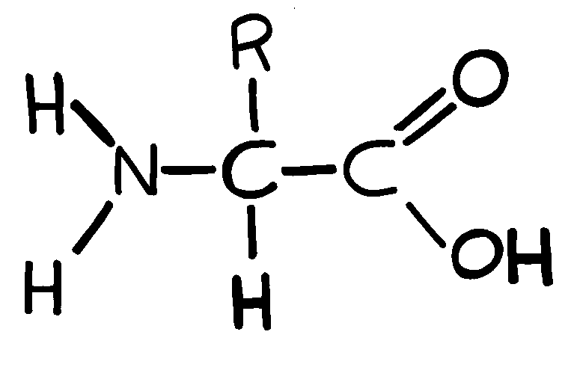
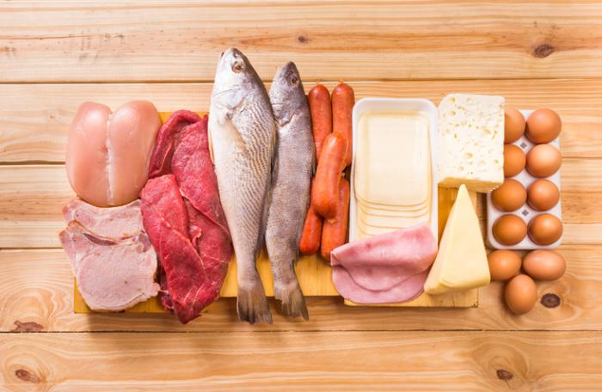
Chapter 5.4:
Proteins
http://www.mrothery.co.uk/images/aa.GIF
Veronica Bucci & Tyler Kemmer
https://cdn1.medicalnewstoday.com/content/images/articles/196/196279/protein-foods.jpg

Slide 2
Different Protein Types and Their Functions
Type Of Protein | Function
Enzymatic Proteins | Enzymes are catalyst, they speed up chemical reactions (lock and key)
Structural Proteins | Support
Storage Proteins | Responsible for storing amino acids
Transport Proteins | Transport different substances
Hormonal Proteins | Coordinates all the organisms activities
Receptor Proteins | Control the cell’s response to chemical stimuli
Contractile and Motor Proteins | Characterized by movement
Defensive Proteins | Protects cell from different diseases

Slide 3
Examples of Protein Function
Type of protein | Example of Function
Enzymatic proteins | The digestive enzymes used to speed up the digestive process
Structural proteins | The connective tissues for animals is provided a fibrous layout by Collagen and elastin
Storage proteins | Casein is a protein in milk that provides amino acids for baby mammals
Transport proteins | Hemoglobin is a protein that contains iron and transports oxygen from the lungs to the rest of the body
Hormonal proteins | The hormone Insulin regulates the concentration of sugar in a vertebrates blood
Receptor proteins | Nerve cells detect chemical signals by receptors built into the membrane
Contractile and Motor proteins | The contraction of muscles is caused by actin and myosin
Defensive proteins | The antibodies are responsible for combating bacteria and viruses

Slide 4
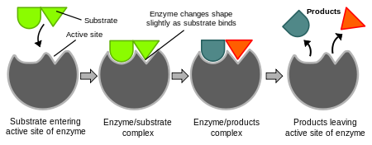
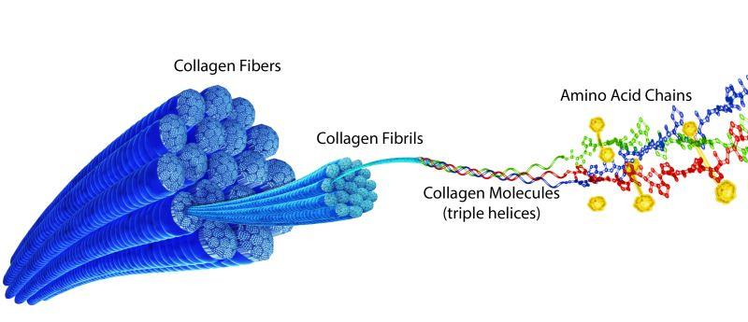
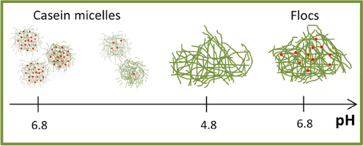
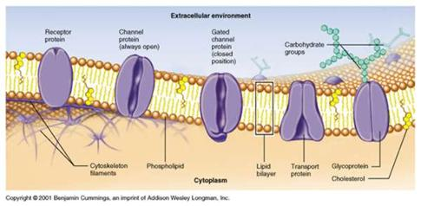
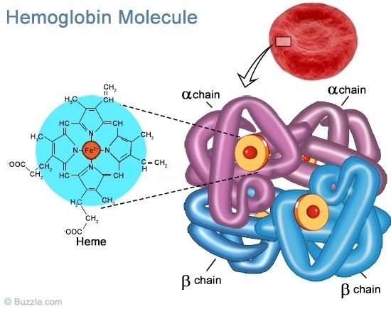
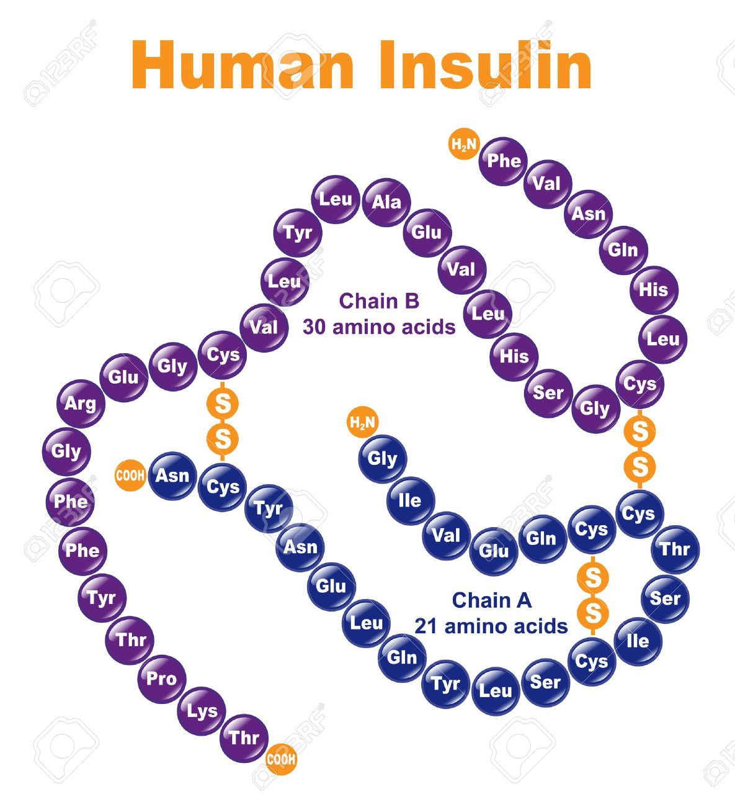
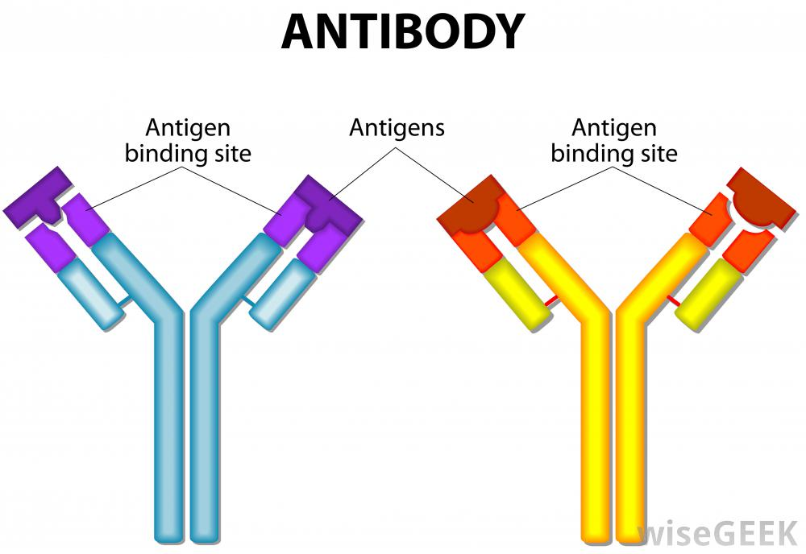
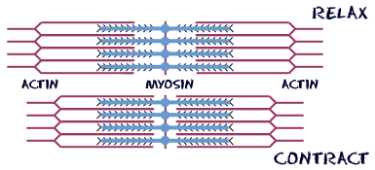
1
2
3
http://www.sciencedirect.com/science/article/pii/S0268005X15001885
https://simple.wikipedia.org/wiki/Enzyme
http://www.harbormedtech.com/bridge
4
5
6
https://www.123rf.com/photo_13207592_human-insulin-stylized-chemical-structure.html
http://spot.pcc.edu/~jvolpe/b/bi112/lec/lessons/wk6/Week%206_CellMembranes.html
https://www.pinterest.com/Tjset/hemoglobin-and-protein-structure/
7
8
Example Pictures
Of
Proteins
http://www.wisegeek.org/what-is-an-antibody.htm
http://www.biology4kids.com/files/cell_microfilament.html

Slide 5
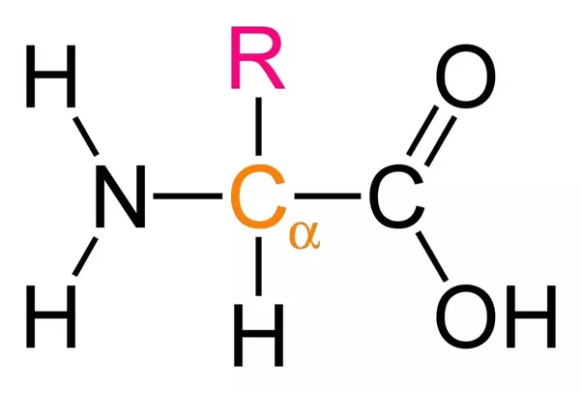
Components of an Amino Acid
Amino group (-NH₂)
Carboxyl group (-COOH): makes molecule behave like a weak acid
Amino and carboxyl group held together through a peptide bond which releases water (dehydration synthesis)
An α (alpha) carbon (C with an H): forms four bonds that allows other groups to become attached
Variable group denoted by R (dependent on amino acid): varies dependent on amino acid, gives alkaline properties
Variable group
Amino group →
← Carboxyl group
α carbon
http://study.com/cimages/multimages/16/amino_acid_structure.png

Slide 6
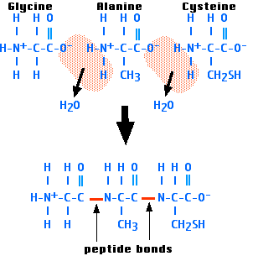
Peptide Bonds
Form between the carboxyl and amino groups
Link together in order to form polymers
Occurs due to a dehydration reaction (removal of water molecules)
Covalent bond
Repeated process that forms polypeptides
Polypeptide chains contain one free amino group and one free carboxyl group on opposite ends
Peptide Bond Formation Animation
https://youtu.be/QGJINzG5Ea0
http://www.biology-pages.info/T/tripeptide.png

Slide 7
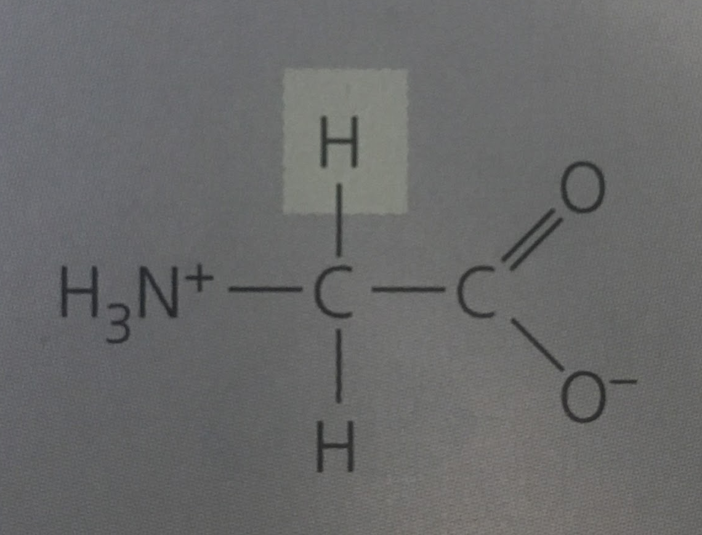
Glycine (Gly or G)
Variable group (H₂)
Amino group
Carboxyl group
α carbon

Slide 8
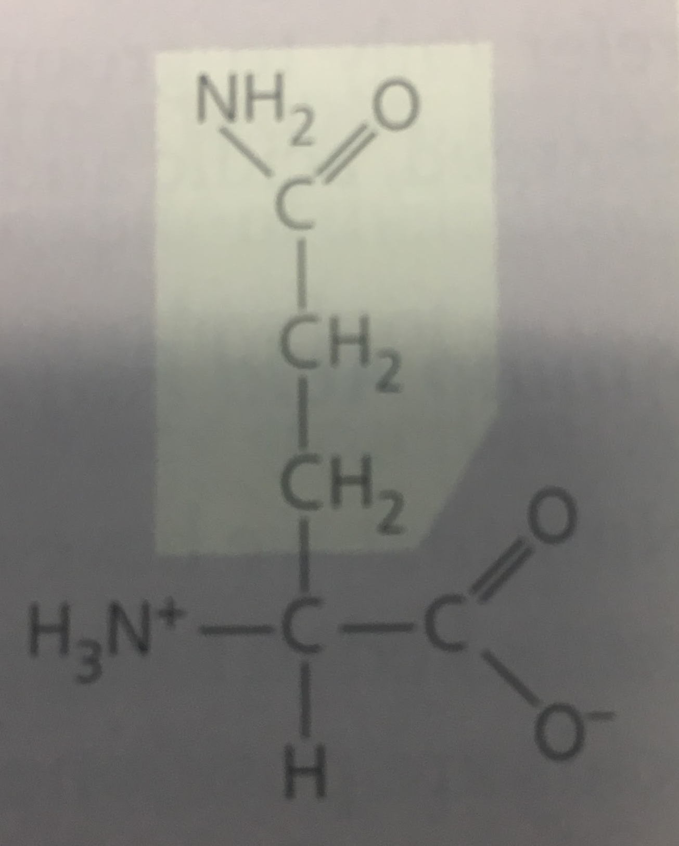
Glutamine (Gln or Q)
Variable group (C₃H₇NO)
Amino group
Carboxyl group
α carbon

Slide 9
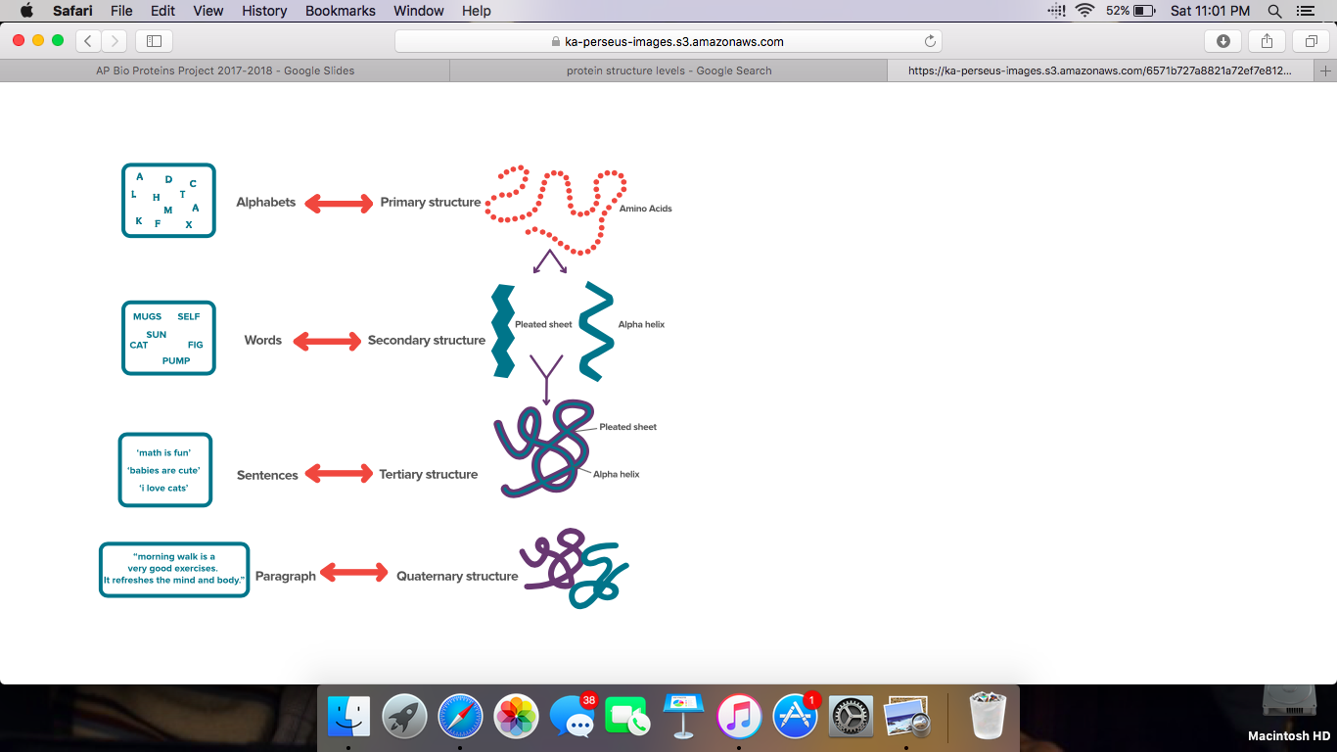
Protein Structure
Comprised into four levels
From most basic to all-inclusive
Organized method to describe a protein
Each level has a specific rule
https://ka-perseus-images.s3.amazonaws.com/6571b727a8821a72ef7e812c6b5b9d765d0f4343.svg

Slide 10
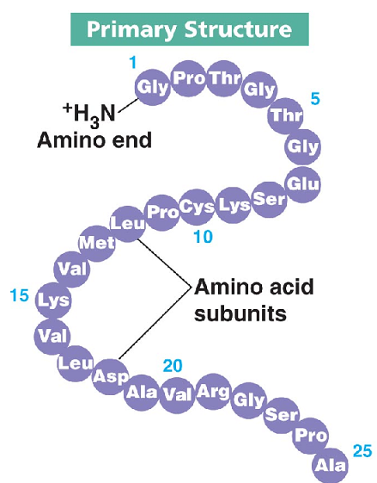
Primary Structure
Unique sequence of amino acids
Connects various subunits together
Allows a viewing of polypeptide chains
Determined by inherited genetic information
http://biology.hi7.co/biology/biology-56ce2a9377e83.png

Slide 11
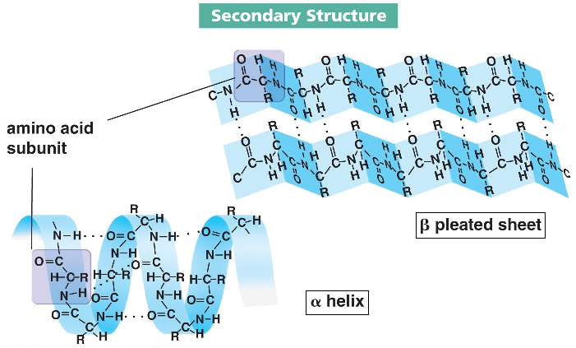
Secondary Structure
Coils and folds of polypeptide bonds due to hydrogen bonds
Contribute to shape
Coils occur due to attractions of hydrogen atoms to nitrogen atoms which have an affinity for oxygen atoms
α helix: coil held by hydrogen bonds at every fourth amino acid
β pleated sheet: two or more regions of side-by-side polypeptide chains between parallel polypeptide backbones
http://1.bp.blogspot.com/-TGSIEzEPiCQ/U93vaqC-KII/AAAAAAAASu4/oUkACRQ8DzI/s1600/secondary+structur

Slide 12
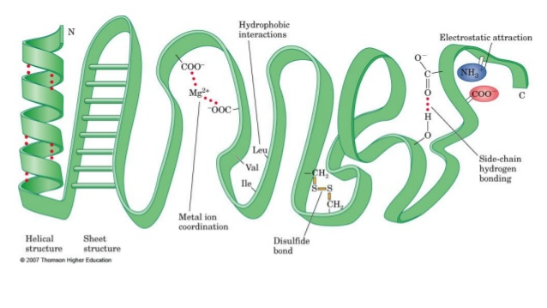
Tertiary Structure
Overall shape of a polypeptide
Caused by interactions between variable groups of amino acids
Hydrophobic rection: folded polypeptide goes into functional shape and hydrophobic side chains end up in a cluster at the core
Nonpolar side chains are held together through van der Waals interactions
Disulfide bridges: two cysteine monomers and amino acids with sulfhydryl groups are brought together through folding; reinforces shape
https://image.slidesharecdn.com/proteins-140302014110-phpapp01/95/proteins-34-638.jpg?cb=1393724557

Slide 13
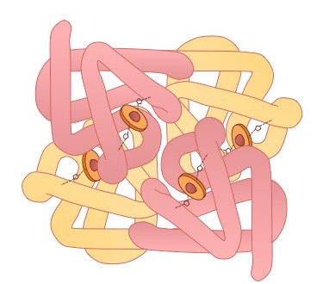
Quaternary Structure
Overall protein structure
Caused by aggregation of polypeptide subunits
Proteins consist of two or more polypeptide chains in one functional macromolecule
Structure fits the function
Each α and β subunit has a non polypeptide component (heme)
http://ib.bioninja.com.au/_Media/quaternary-structure_med.jpeg

Slide 14
Denaturation of Proteins
Denaturation of Proteins: this is when proteins lose their secondary, tertiary, and quaternary structures but not their primary structures because denaturation reactions are not strong enough to break the polypeptide bonds.
Denaturation of Proteins occurs with:
Strong acids and alkalis
Heavy metals
Heat and radiation
Detergents and solvents
These are reversible!

Slide 15
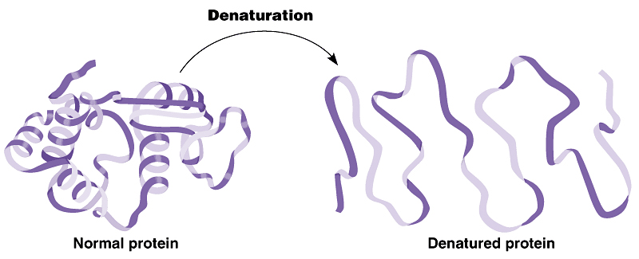
Strong Acids and Alkalis
Acids
http://foodslashscience.blogspot.com/2010/11/cooking-meat-thermodynamics-and.html
How:
The ionic bonds are disrupted and as a result the protein clumps into a soft solid like substance, this is the first step in the digestion if a protein
When a protein is exposed to an acid for too long, the primary structure of the protein will break down

Slide 16
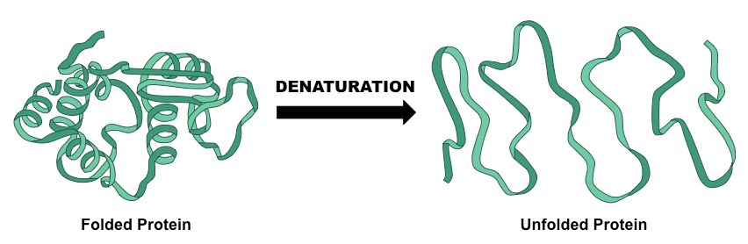
Heavy metals
Heavy metals
http://ib.bioninja.com.au/standard-level/topic-2-molecular-biology/24-proteins/denaturation.html
How:
This will denature the protein by disrupting the ionic bonds and forming new bonds with the carboxyl groups therefore reducing the protein charge and lead to the precipitation of the protein

Slide 17
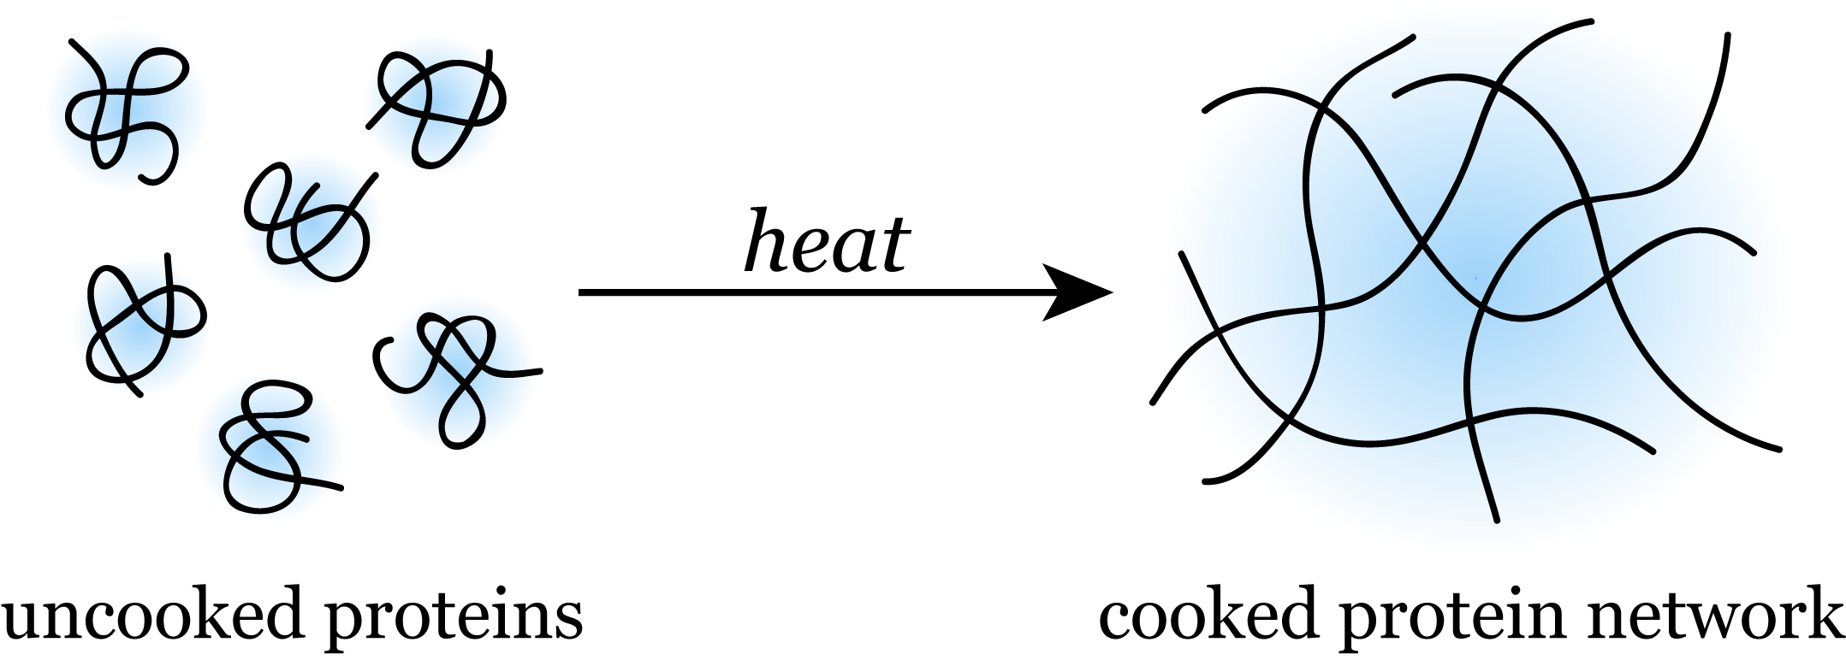
Heat and Radiation
https://scienceandfooducla.wordpress.com/2013/03/26/ceviche/
How:
The addition of heat or radiation leads to an increase of energy that is given to the atoms which causes disruption within the bonds

Slide 18
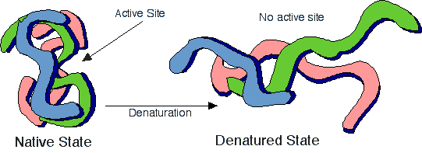
Detergents and Solvents
Detergents and solvents
How:
Adding detergents and solvents allows bonds to form with the nonpolar groups within the protein, thereby distributing the hydrogen bonds
http://bioap.wikispaces.com/Ch+5+Collaboration+2010?responseToken=669752a3ba0d1aacca3c1dfa0aca3acf

Slide 19
References
1. Reece, J. B., Urry, L. A., Cain, M. L. 1., Wasserman, S. A., Minorsky, P. V., Jackson, R., & Campbell, N. A. (2007). Campbell biology (Eighth edition.). Boston: Pearson.
2. Charles E. Ophardt (2003).Denaturation of Proteins. Retrieved fromhttp://chemistry.elmhurst.edu/vchembook/568denaturation.html

