Slide 1
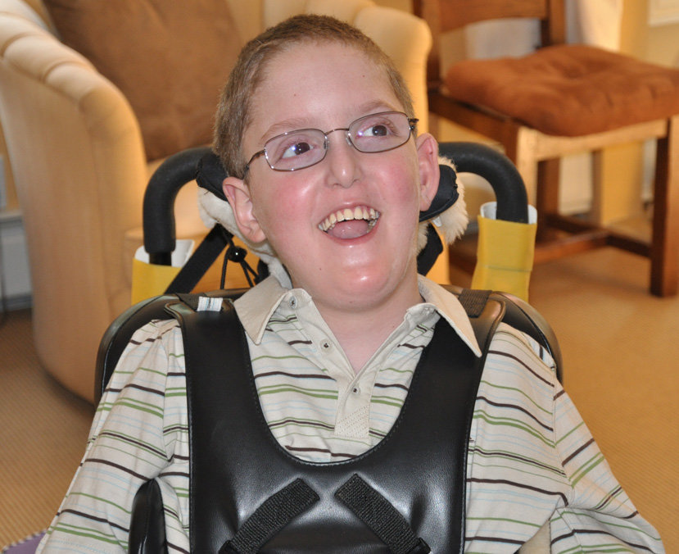
Canavan Disease
Veronica Bucci
AP Biology 2018

Slide 2
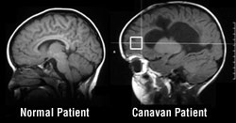
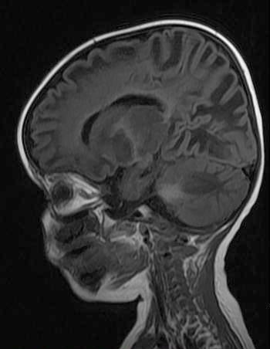
What is Canavan Disease?
A fatal, neurological disorder
Myelin (white brain matter) begins to deteriorate within infancy
Caused by the lack of the enzyme aspartoacylase which is in brain neurons
Nerve cell signals cannot be transmitted
Known as a leukodystrophy
Diagnosis
Occurs within 3 to 9 months after an infant has been born
Genetic testing for the enzyme aspartoacylase

Slide 3
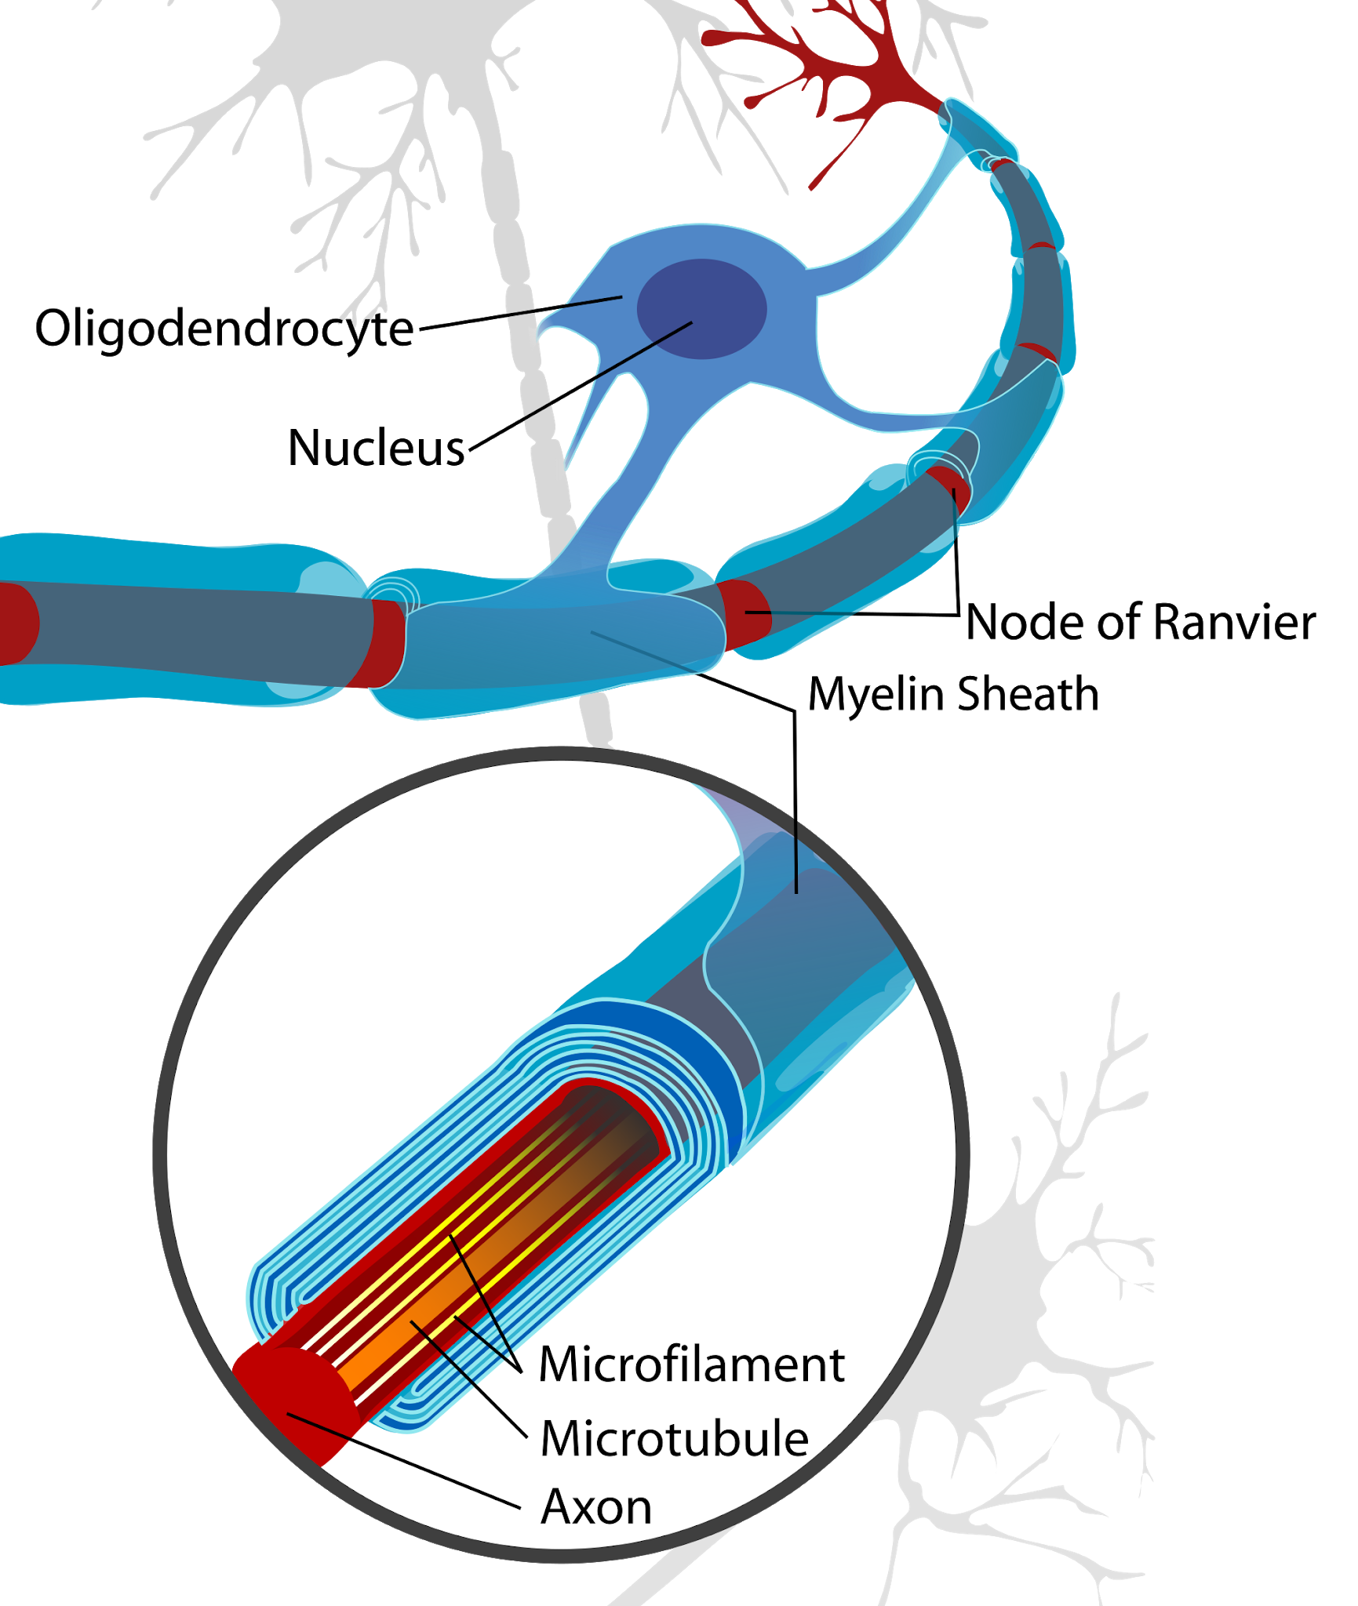
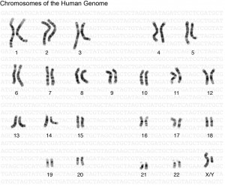
Genotype
An autosomal recessive disorder
Allele located on chromosome 17
Leads to axons of neurons being insulated, degenerated, and unable to function

Slide 4
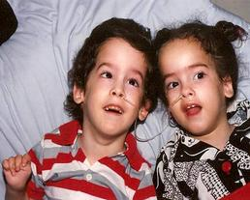
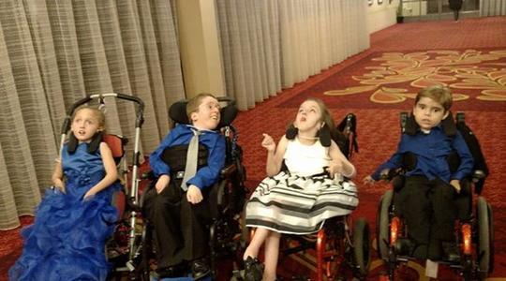
Phenotype
Lack of intellectual ability
Regression of motor skills
Problems eating
Impaired head control
Increasing head circumference
Slower visual response
Abnormal muscle tone
Seizures
Paralyzation
Blindness
Deafness
Difficulty swallowing

Slide 5
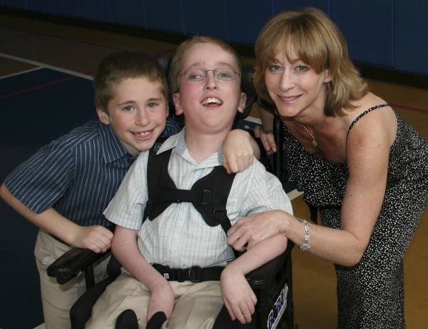
Treatment
Currently, there is no cure.
Research is investigating
  Gene therapy (Janson, et al., 2002)
  Immune system responses (McPhee, et al., 2006)
  Transfer of aspartoacylase into the body (Leone, et al., 2000)
Children and parents are taught simply how to manage symptoms

Slide 6
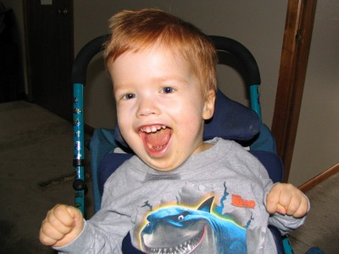
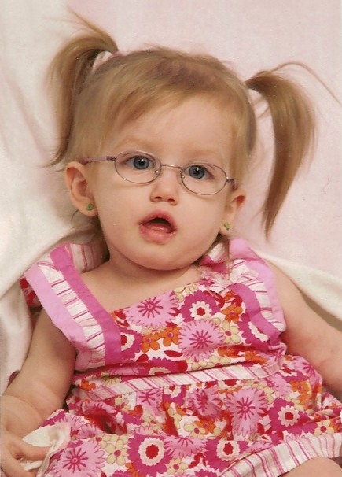
Prognosis
Most children do not live past 10 years of age
Very rare to live to be a teenager
Most deaths occur before age 4
Prominent within the Ashkenazi Jew population
1 in 40 are a carrier for the disease from the Jewish population
Neurons are essentially rotted away
The brain becomes completely degraded

Slide 7
References
Video
https://www.youtube.com/watch?v=pam3xyAvl1w
Citations
http://www.canavanfoundation.org/about_canavan_disease
https://ulf.org/canavan-disease/
https://ghr.nlm.nih.gov/condition/canavan-disease
https://en.wikipedia.org/wiki/Canavan_disease
Janson, C., McPhee, S., Bilaniuk, L., Haselgrove, J., Testaiuti, M., Freese, A., ... & Saslow, E. (2002). Gene therapy of Canavan disease: AAV-2 vector for neurosurgical delivery of aspartoacylase gene (ASPA) to the human brain. Human gene therapy, 13(11), 1391-1412.
McPhee, S. W. J., Janson, C. G., Li, C., Samulski, R. J., Camp, A. S., Francis, J., ... & Leone, P. (2006). Immune responses to AAV in a phase I study for Canavan disease. The journal of gene medicine, 8(5), 577-588.
Leone, P., Janson, C. G., Bilianuk, L., Wang, Z., Sorgi, F., Huang, L., ... & McPhee, S. W. (2000). Aspartoacylase gene transfer to the mammalian central nervous system with therapeutic implications for Canavan disease. Annals of neurology, 48(1), 27-38.

