Slide 1
Phenylketonuria
By Grace Schartau

Slide 2
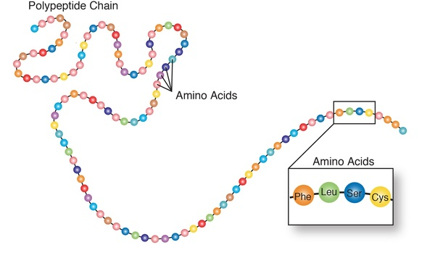
Types of PKU
Two types:
Classic PKU
Most severe with enzyme completely missing
Extremely high PKU levels
Hyper-Phenylketonuria
Phenylalanine blood levels are higher than average (2mg/dL)
Levels are not as high as Classic type
Parts of enzyme present

Slide 3
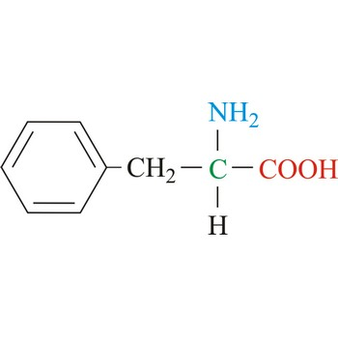
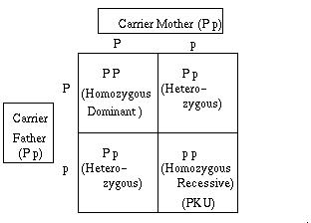
Genotype of PKU
Autosomal recessive trait
Both parents must carry defective gene for child to have PKU
Missing enzyme: phenylalanine hydroxylase
Found on chromosome 12
1 of 8 essential amino acids in protein rich foods but can’t be used
Buildup of phenylalanine in body is toxic to nervous system

Slide 4
Phenotype of PKU
Newborns don't tend to show symptoms, only if untreated will these occur:
A musty odor in the breath, skin or urine
Skin rashes (eczema)
Fair skin and blue eyes- melanin interference
Hyperactivity/ADHD
Intellectual disability
Behavioral, emotional and social problems
If the low-phenylalanine diet is not followed:
Mental retardation as nervous system and brain are poisoned

Slide 5
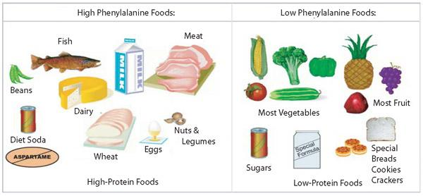
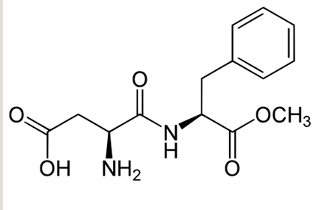
Treatment for PKU
Strict low phenylalanine diet, especially as a child
Limited amounts of eggs, milk, and high protein foods
Aspartame (artificial sweetener) must be avoided
Lofenalac is specific formula for PKU infants
Low phenylalanine levels
Must get levels checked and monitored multiple times annually
Blood test done to determine phenylalanine levels

Slide 6
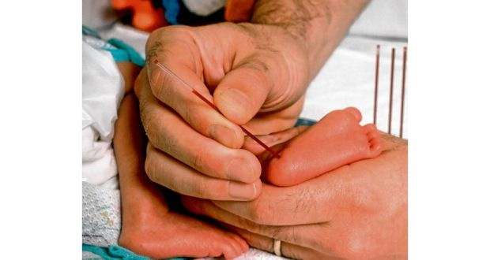
Prognosis for PKU
If dietary restrictions are followed/levels monitored:
Positive prognosis with no serious health problems
Left untreated/treated improperly:
Will develop movement disorders and mental retardation
To avoid this:
All babies in the United States and Canada are tested for PKU right after birth.
The blood sample for PKU is usually taken from your baby's heel (called a heel stick).
Test is done in the first few days after birth, as early as 24 hours after birth.

Slide 7
References
Pey, A. L., Desviat, L. R., Gámez, A., Ugarte, M., & Pérez, B. (2003, April). Phenylketonuria: genotype-phenotype correlations based on expression analysis of structural and functional mutations in PAH. Retrieved February 22, 2018, from https://www.ncbi.nlm.nih.gov/pubmed/12655546
Phenylketonuria (PKU). (2018, January 27). Retrieved February 22, 2018, from https://www.mayoclinic.org/diseases-conditions/phenylketonuria/symptoms-causes/syc-20376302

